Slide 1
Operating Systems
WEEK 3-OS Structures, System calls and Modes of OS

Slide 2
Importance of OS Structures:
Helps in understanding how OS components interact.
Aids in designing efficient and modular operating systems.
Allows customization for specific system needs.

Slide 3
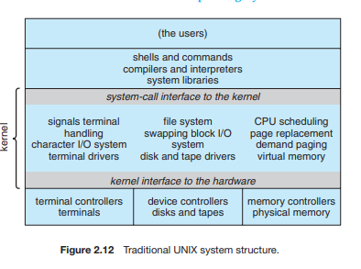
Types of OS Structures
Monolithic System:
Entire OS runs as a single program in kernel mode.
Example: UNIX.
Advantages:
High performance due to minimal inter-process communication (IPC).
Simple design and efficient execution.
Disadvantages:
Difficult to modify and maintain due to tight integration.
A single bug can crash the entire system.

Slide 4
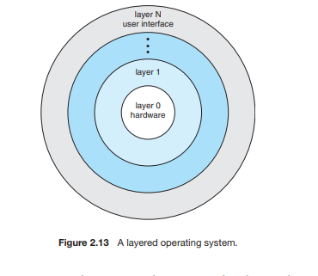
Types of OS Structures
Layered Approach:
OS is divided into multiple layers, each built on top of the lower one.
Example: THE operating system.
Advantages:
Modular design simplifies debugging and system updates.
Easier to develop and maintain due to clear separation of functionalities.
Disadvantages:
Performance overhead due to additional layers of abstraction.
Defining correct layer interactions can be complex.

Slide 5
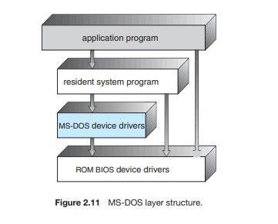
Types of OS Structures
MS-DOS System:
A simple structure where applications directly interact with hardware through the kernel.
Example: MS-DOS.
Advantages:
Fast and lightweight due to minimal overhead.
Direct access to hardware improves efficiency for certain tasks.
Disadvantages:
Lack of security and protection between processes.
Poor multitasking support as it follows a single-tasking approach.

Slide 6
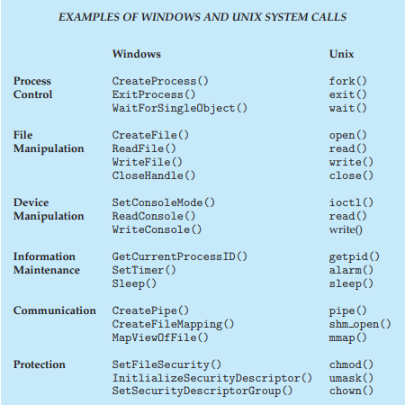
System Calls
Definition:
A system call is a mechanism that allows user applications to request services from the OS kernel.
Purpose and Importance:
Provides controlled access to hardware and resources.
Enables process management, file handling, and communication.
Acts as a bridge between user programs and OS functions

Slide 7
Categories of System Calls
Process Management:
Create, terminate, execute, and manage processes.
Example: fork(), exec(), exit().
File Management:
Open, read, write, close files.
Example: open(), read(), write(), close().
Device Management:
Request and release device access.
Example: ioctl(), read(), write().

Slide 8
Categories of System Calls
Information Maintenance:
Get and set system time, process information.
Example: getpid(), settimeofday().
Communication:
Create, send, and receive messages between processes.
Example: pipe(), msgsend(), msgrcv().

Slide 9
Modes of OS
User Mode vs. Kernel Mode:
User Mode: Executes user applications with limited privileges.
Kernel Mode: Executes OS code with full control over system hardware.
Privileged Instructions:
Certain instructions (e.g., I/O operations, memory management) can only execute in kernel mode.
Mode Bit Mechanism:
A hardware-supported bit that distinguishes between user mode (0) and kernel mode (1).

Slide 10
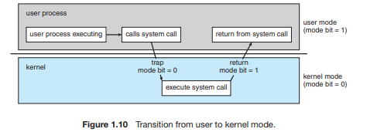
Transition Between Modes
How System Calls Switch Modes:
A system call triggers a switch from user mode to kernel mode.
Example: open() system call moves from user mode to kernel mode to access files.
Examples of Kernel and User Mode Operations:
Kernel Mode: Memory allocation, hardware access, scheduling.
User Mode: Running applications, executing code without direct hardware access

